Slide 1


No-Code Machine Learning with RapidMiner Studio
Brief Software Introduction and Tutorial for Paleo Climate Reconstruction Research
https://docs.rapidminer.com/9.9/studio/getting-started/design-view.html

Slide 2
1. Installation Guide

Slide 3
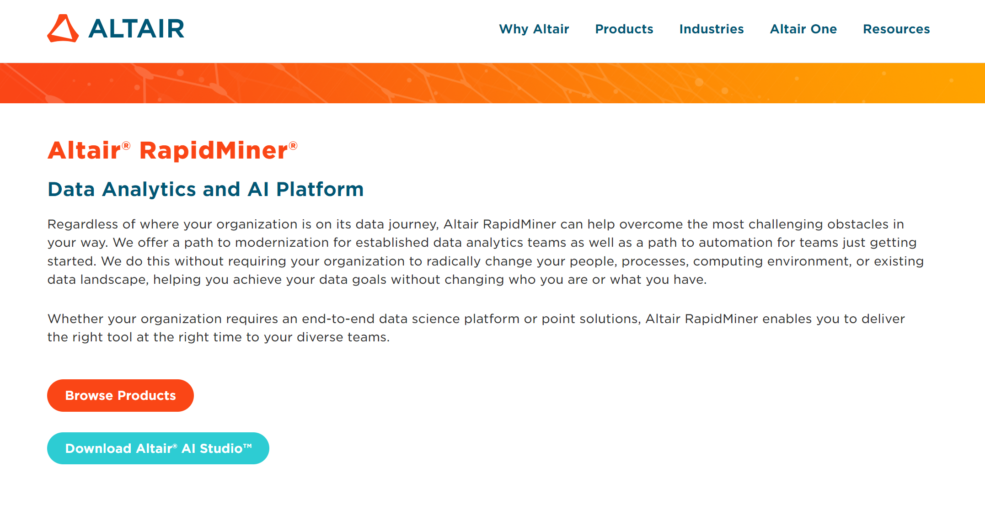
Downloading RapidMiner Studio
Go to the RapidMiner website https://altair.com/altair-rapidminer
Click “Download Altair AI Studio”

Slide 4
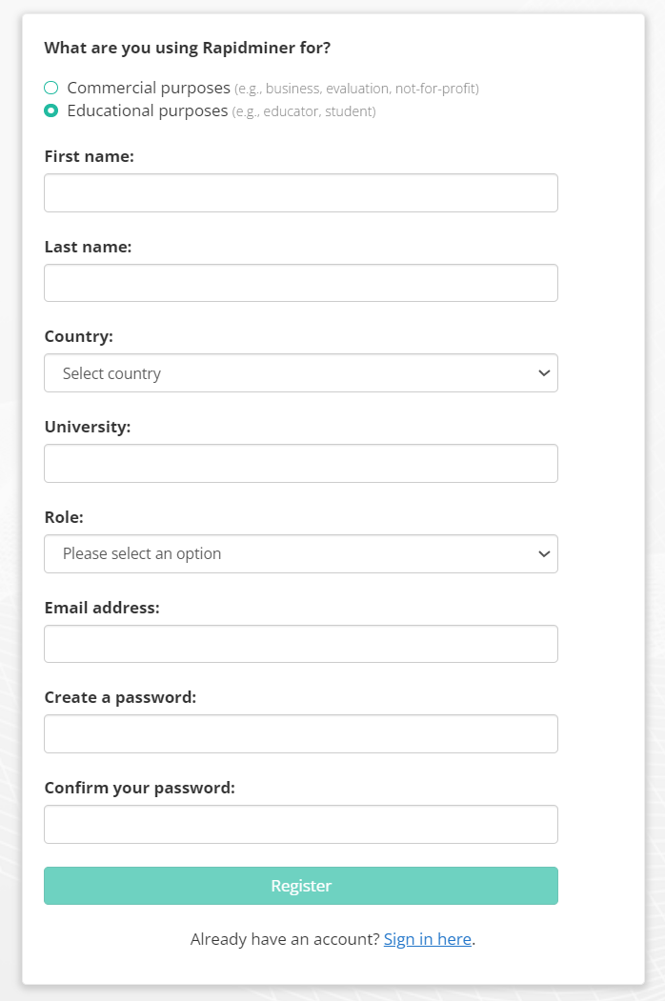
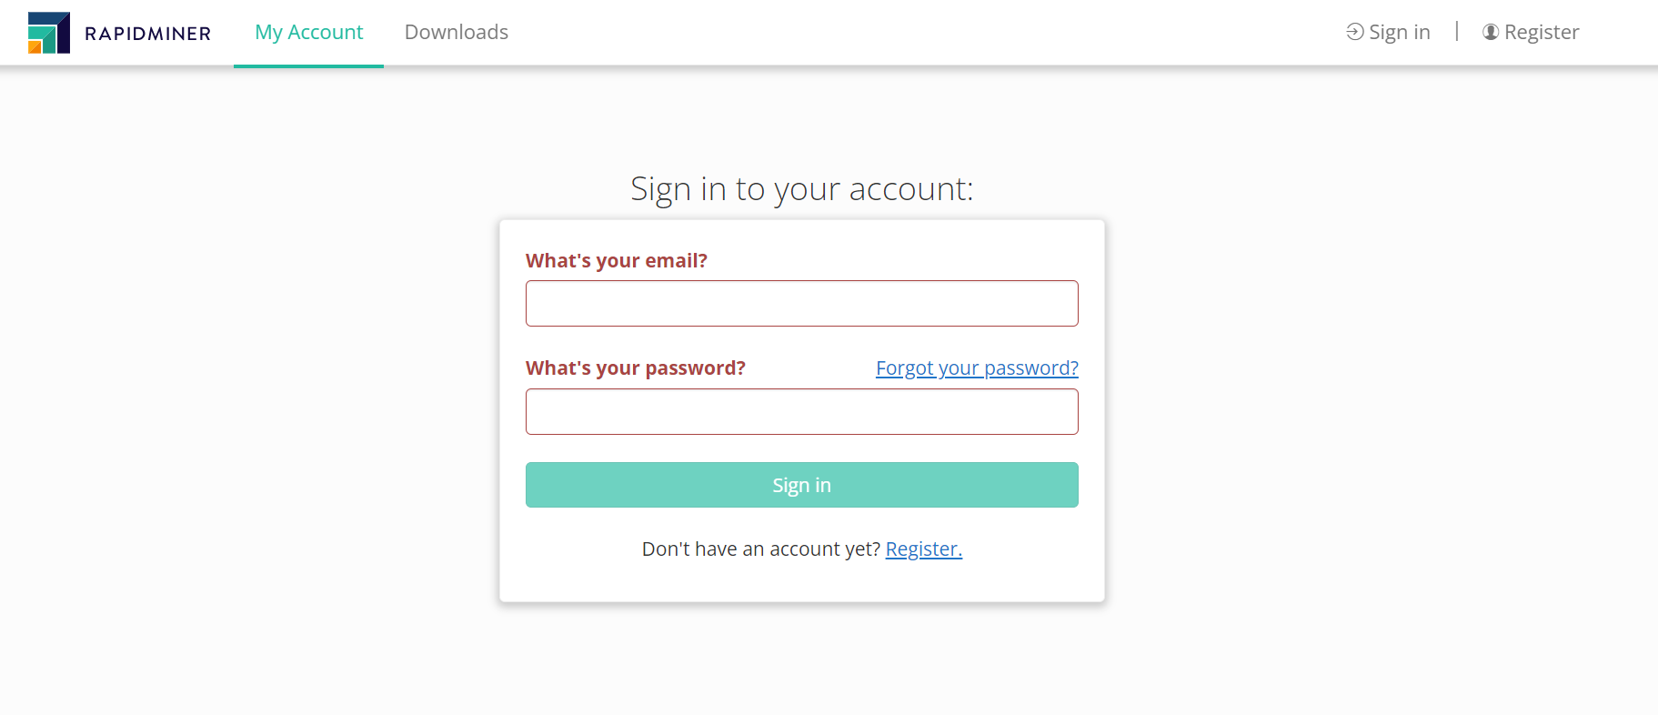
Downloading RapidMiner Studio
Either sign in to your RapidMiner account or register to create an account when prompted (no cost).

Slide 5
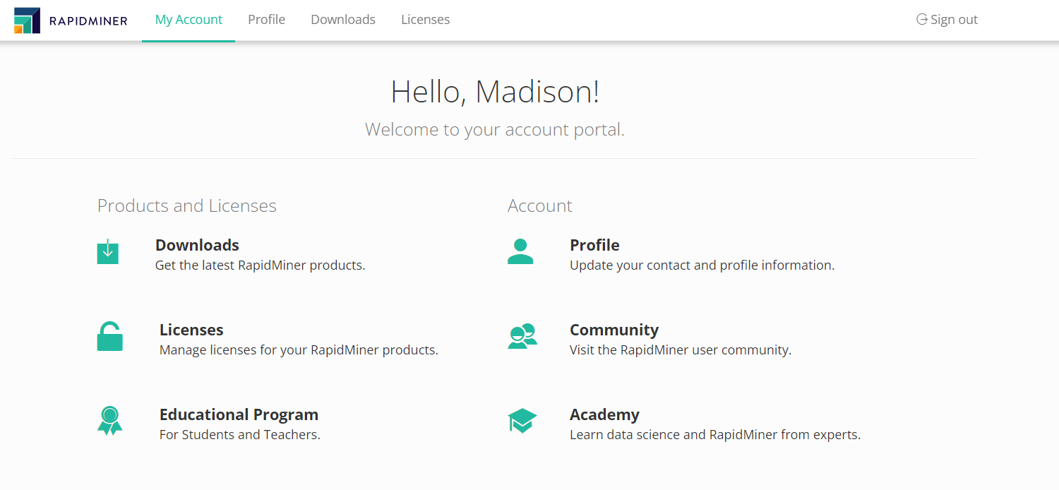
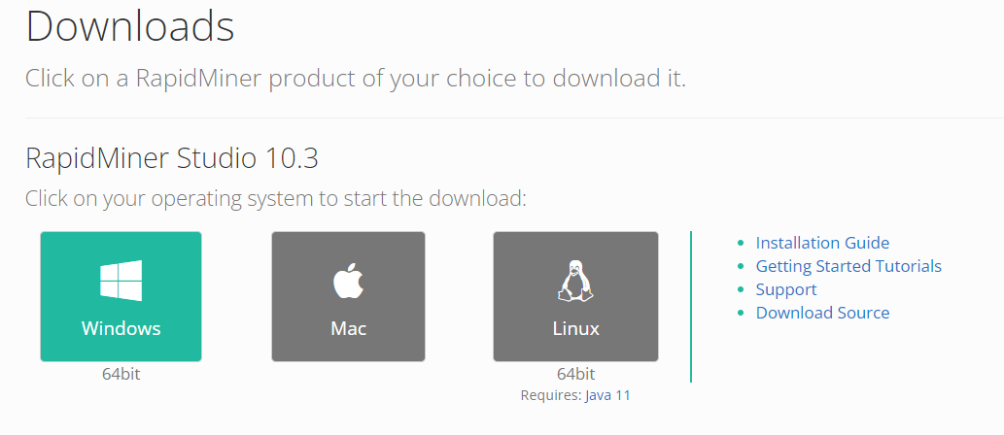
Downloading RapidMiner Studio
Once logged in, you will be brought to your account portal. Select “Downloads”
Select your operating system to start the download of the software.

Slide 6
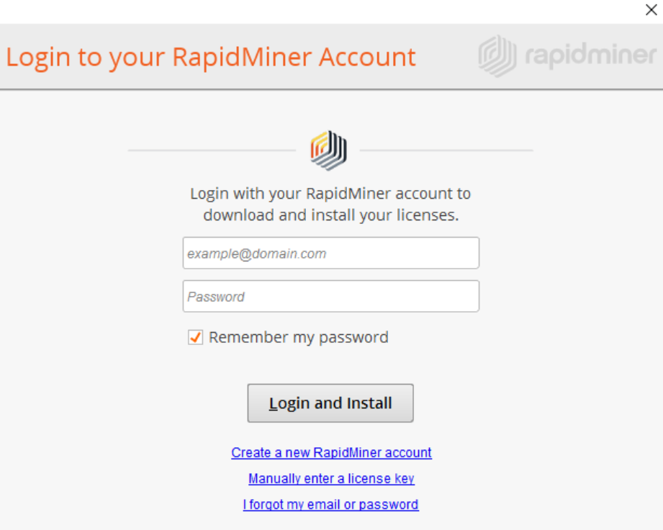
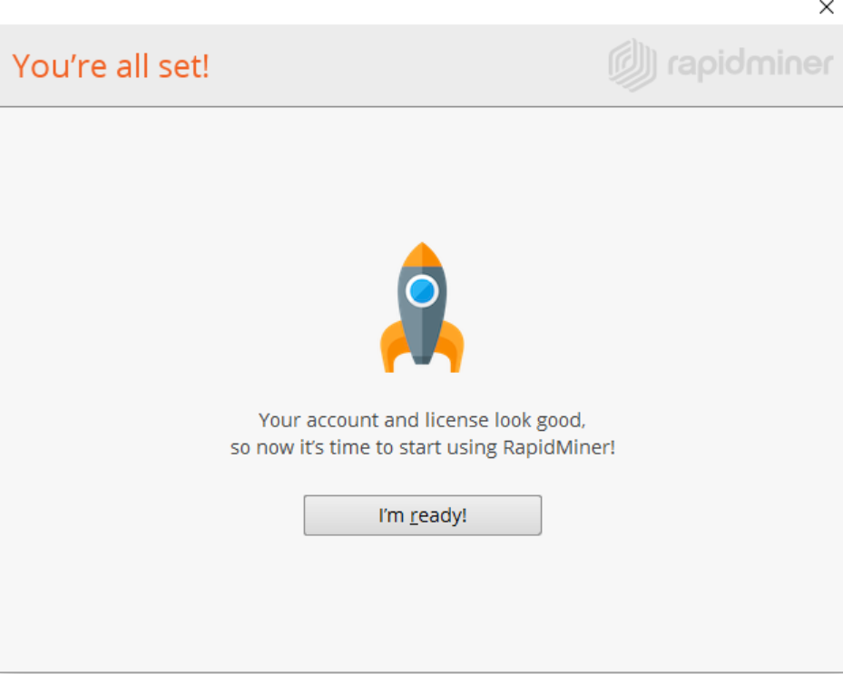
Installing & Launching RapidMiner Studio
When the download completes, install the platform following the instructions appropriate to your platform.
In-depth installation instructions for each platform can be found here: https://docs.rapidminer.com/9.9/studio/installation/index.html
When launching RapidMiner Studio, you will be prompted to sign in with your account credentials.
Select “login and install”
Once installed, select “I’m ready!” to begin using the platform.

Slide 7
2. Software Overview

Slide 8
Introduction
“RapidMiner Studio is a visual workflow designer for predictive analytics that brings data science and machine learning to everyone on the analytics team.”
RapidMiner Studio follows a typical data analytics workflow for intuitive use:
Import data
Prepare data
Build a model
Validate the model
Apply the model
RapidMiner Studio has resources to assist in model building for a variety of research applications:
Turbo Prep https://docs.rapidminer.com/9.9/studio/guided/turbo-prep/
Auto Model https://docs.rapidminer.com/9.9/studio/guided/auto-model/index.html
RapidMiner Community https://community.rapidminer.com/

Slide 9
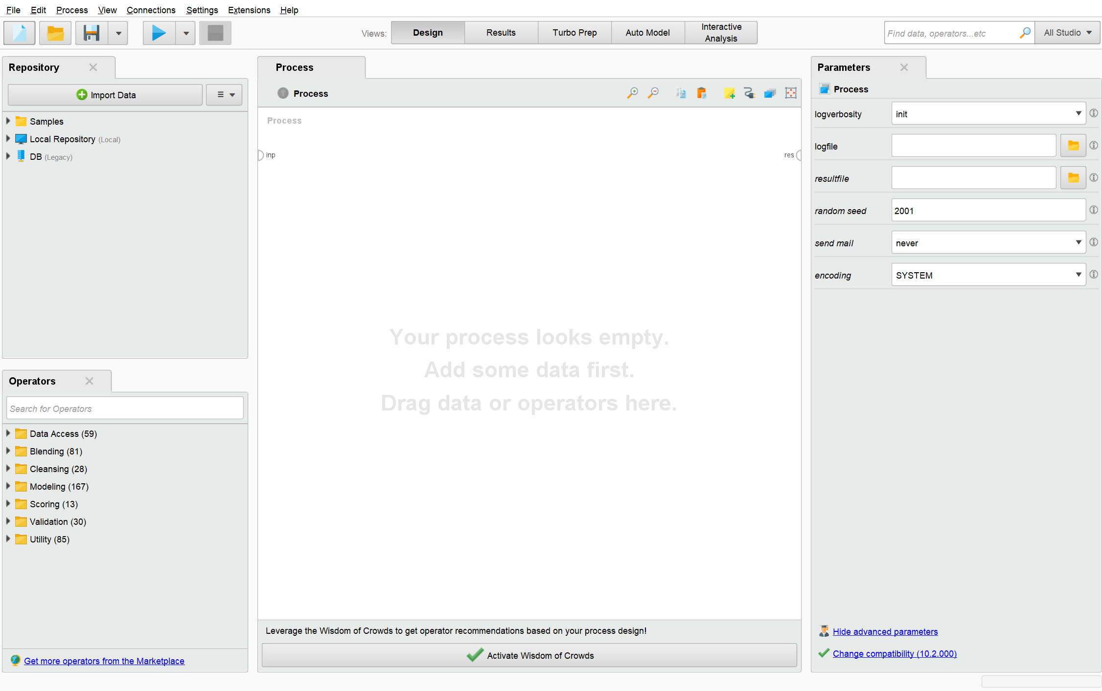
Interface Layout – Default View
When loaded, RapidMiner will prompt you to either create a process or open an existing one.
Data, processes, and results are stored in the Repository.
The essential elements of every workflow are called Operators.
Operators are connected via ports. The output of the first is passed as input to the second.
A connected set of Operators that help you to transform and analyze your data is called a process.
The behavior of an Operator can be modified by changing its parameters.
The behavior of an Operator can be understood by reading the Help.
View navigator
Repository
Process panel
Parameters panel
Operators panel

Slide 10
Processes (Models)
Process: A connected set of Operators that help you to transform and analyze your data.
Also known as: flow, program, pipeline, diagram
Your goal is to create a finished process that produces a result.
Example: Reading a dataset and building a predictive model.
After connecting all operators and setting their parameters, press the Run button at the top of the screen. Results will be displayed in the Results view.
To manage complex or large processes:
Group operators into a single ‘Subprocess’ Operator
Run processes within anther process, via ‘Execute Process’ Operator
To save your process to the repository, select File > Save Process from the main menu.
Processes can be exported as .rmp or .xml

Slide 11
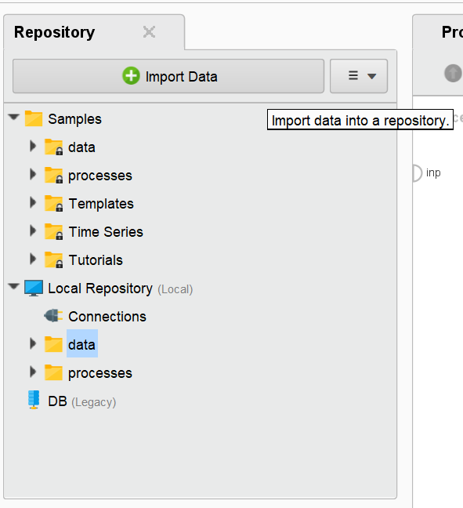
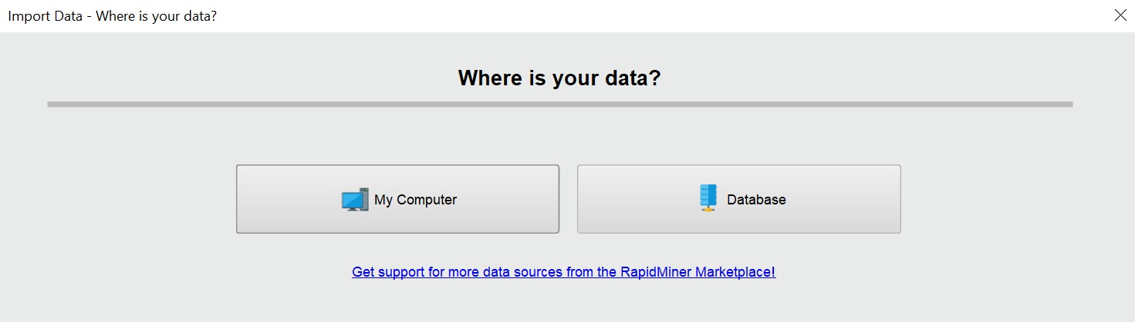
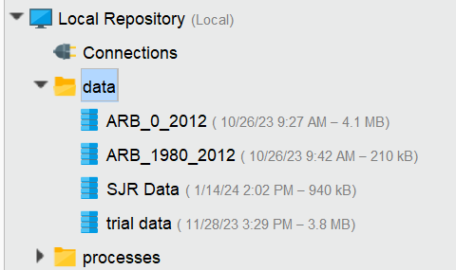
Importing Data to Repository
Repository: your central data storage entity. It holds connections, data, processes and results, either locally or remotely.
Select “Import Data”
Choose to load data from your device or database
If loading from a database, the database must be linked to your repository via the connections tab prior to importing.
If loading from your computer, excel files and csv files are accepted.
Import multiple files for access in local repository.

Slide 12
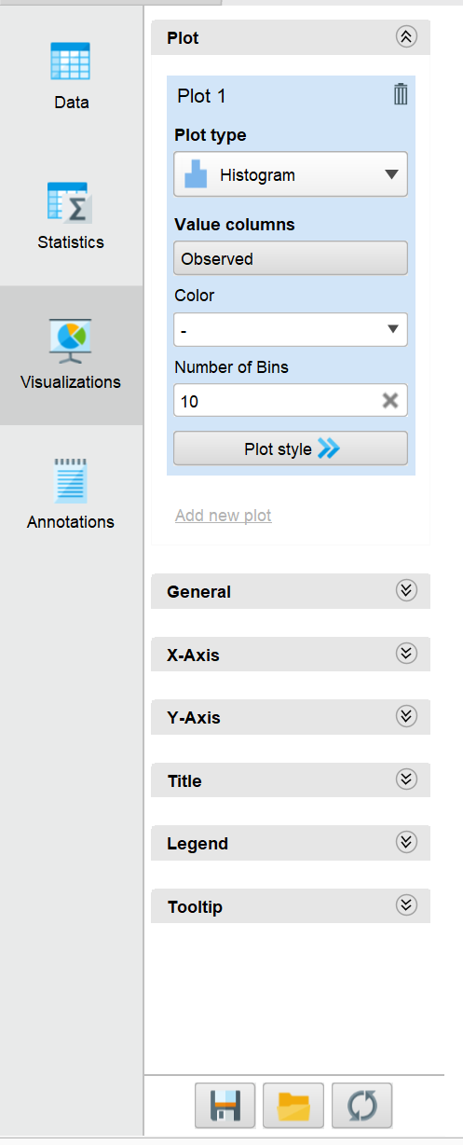
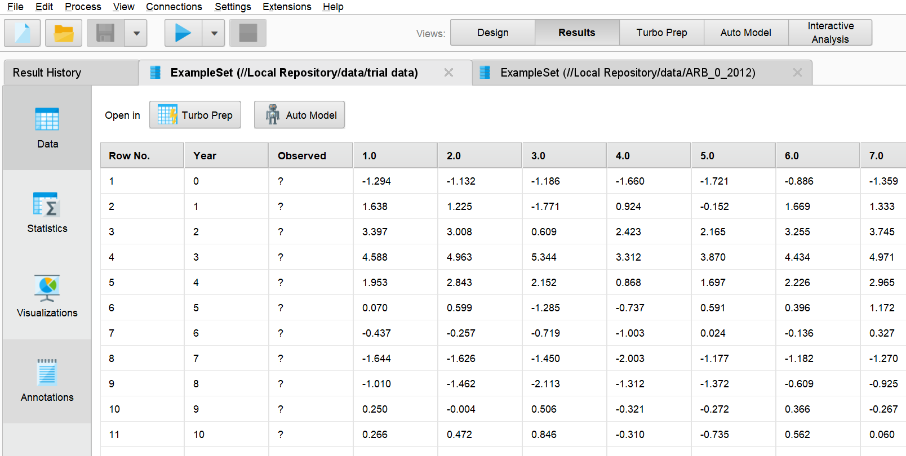
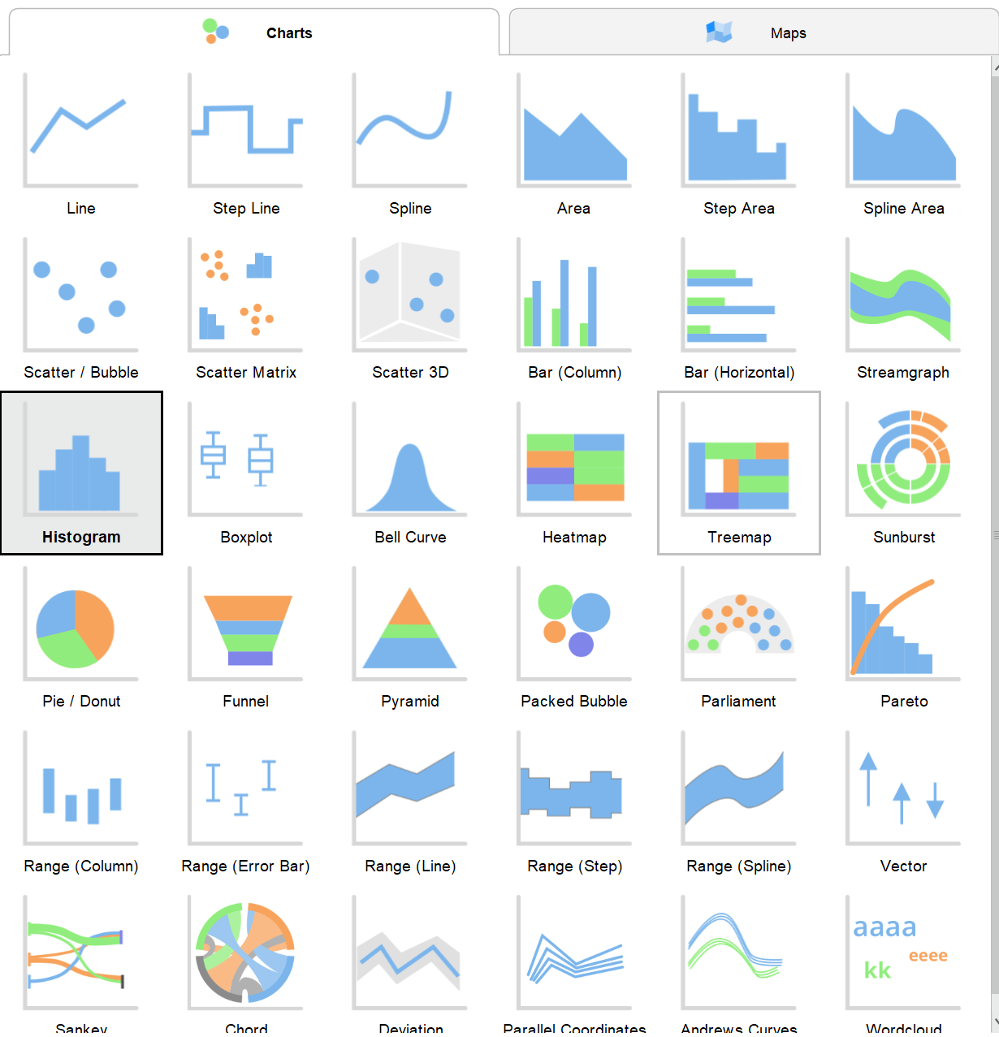
Viewing & Visualizing Imported Data
Double clicking the data within your repository allows you to analyze, visualize, and/or sort the raw data if desired.
Will be displayed in the results view. Select “Design” view to return.
Visualize data with a variety of plot / map styles
View raw imported data
View max, min, and average stats of columns
Visualize data
Create annotations

Slide 13
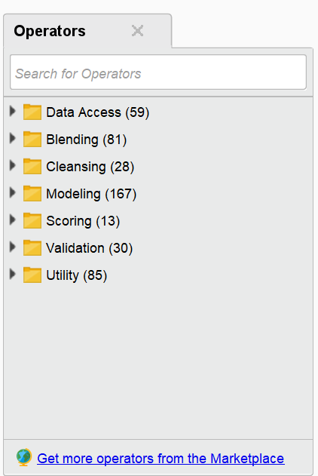
Operators
The elements of a process, each operator takes input and creates output, depending on the choice of parameters.
Aka: Function, formula, node
RapidMiner Studio contains hundreds of operators, with different functionality depending on what you need.
See the Operator Reference Guide for in-depth explanations of the built-in operators within RapidMiner Studio. https://docs.rapidminer.com/9.9/studio/operators/index.html
Search for operators with hierarchical search or keyword search.
The hierarchy of folders in the Operators Panel reflects a typical data science workflow.
The Operators Panel also contains a search field for keywords, or you can search for additional in the Marketplace.
3 ways to insert an operator into the process panel:
Drag-and-drop the operator
Double click the operator
Right click and chose “Insert operator” from the drop-down menu

Slide 14
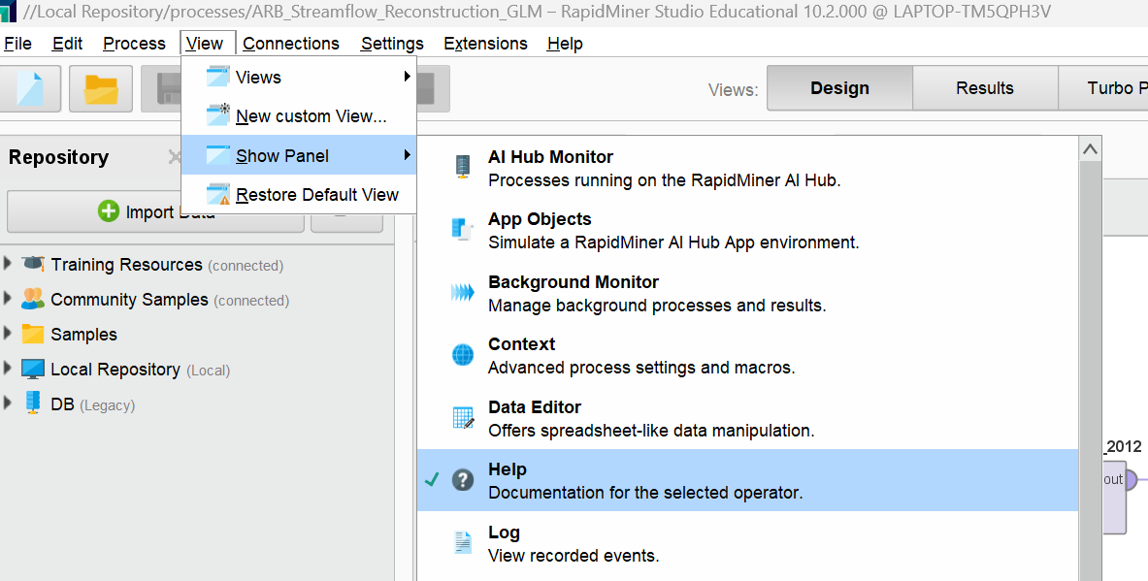
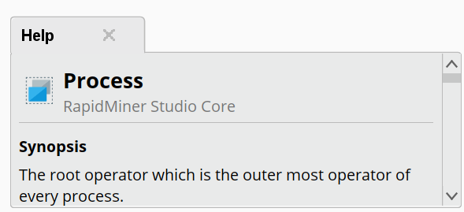
Operator Selection
Help with operators: Select the “View” tab in the top left, “Show Panel” and select “Help.”
This will add a help panel to your default layout, which describes the usage of each operator.
Navigating the operator panel through the hierarchical search is a good way to select operators for:
Data Access (reading/writing data)
Blending (grouping, filtering, re-order, selecting, manipulating roles, etc.)
Cleansing (normalization, duplicate detection, outlier elimination, etc.)
Modeling (algorithms, decision trees, correlations, predictive, optimizations, time series, etc.)
Scoring (confidences, uncertainty, prediction explanations, model applications, insights, etc.)
Validation (performance metrics, cross-validation, etc.)
Utility (scripting, process controls, annotations, macros, etc.)
The help panel is a useful tool for navigating operator functions when building a model.
Or visit the RapidMiner Operator Manual
https://docs.rapidminer.com/9.9/studio/operators/index.html

Slide 15
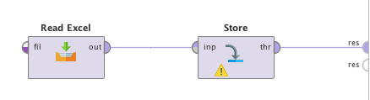
Process Building & Ports
To build a process:
Connect the output from each Operator to the input of the next via a port.
To connect two ports, click them. Hover over a port to see a tooltip with additional information.
When connecting two operators, you must make sure the output port of the first is compatible with the input of the second, or you will see an error message.
Connect the last operator in a process to the results port (“res) on the right side of the Process Panel.
Double click on an output port and it will connect to the next available results port.
Simple process example: data from an excel file is (1) read, (2) stored in the repository, and (3) displayed in the results view.

Slide 16
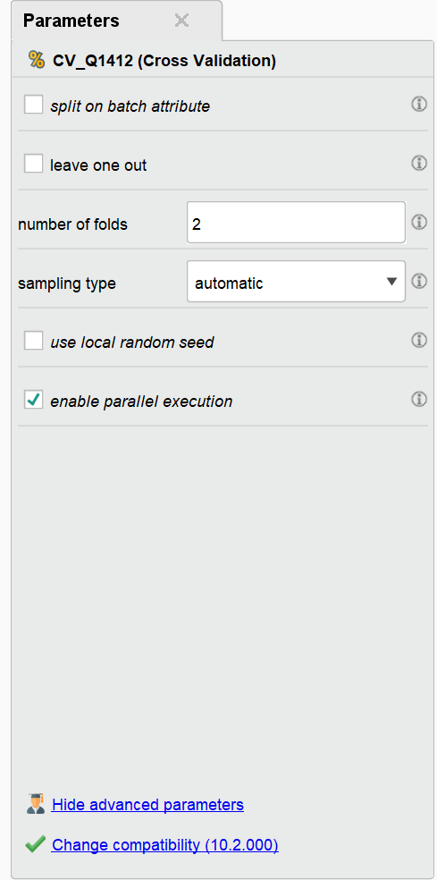
Parameters
Parameters: Options for configuring the behavior of an operator.
Context-dependent
Parameters panel will display the parameters for the selected operator in the process panel.
Each operator has its unique parameters, with default parameters being loaded to the operator automatically.
Parameters can be manipulated within the parameters panel.
To see all available parameters for the operator, click “show advanced parameters”
Example: Parameters Panel for Cross Validation Operator
To see more information on each parameter, hover the information icon next to the parameter of interest, and help text is displayed.

Slide 17
3. Example of RapidMiner Process for Paleo Streamflow Reconstruction (Single Vector)
Associated RapidMiner Process File = SF_Holston_JJAS_ML_Process.rmp

Slide 18
Background
Goal: Use machine learning (i.e. random forest, generalized linear model, and deep learning) to reconstruct annual streamflow measurements at the SF Holston USGS stream gauge (Tennessee Valley).
Desired Outputs: ML reconstructed streamflow vectors and performance metrics (i.e. R^2 and RMSE)
Data Available:
1. Average Summer Streamflow Volumes (June-September), in million cubic meters (MCM) for the SF Holston Gauge from 1932-2005.
2. Self-calibrating Palmer Drought Severity Index (scPDSI) annual gridded data, within 450-km radius of SF Holston gauge, from 365-2005.

Slide 19
Steps
Format data for import
Import data into Repository
Retrieve data in Process
Set data roles
Filter examples for period of observation
Cross validation
Select algorithm/model desired
Set number of folds
Route performance measurement output
Apply model, view results

Slide 20
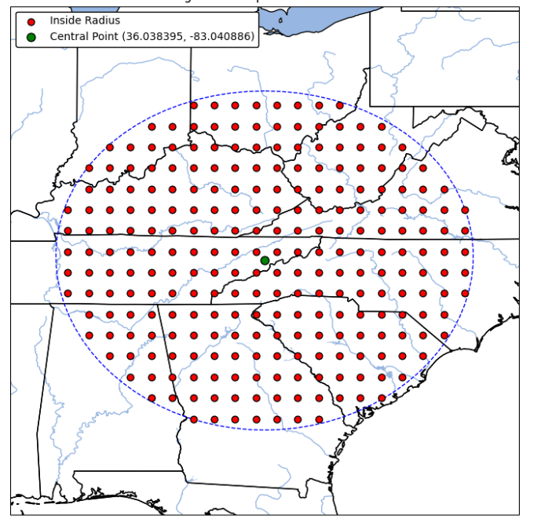
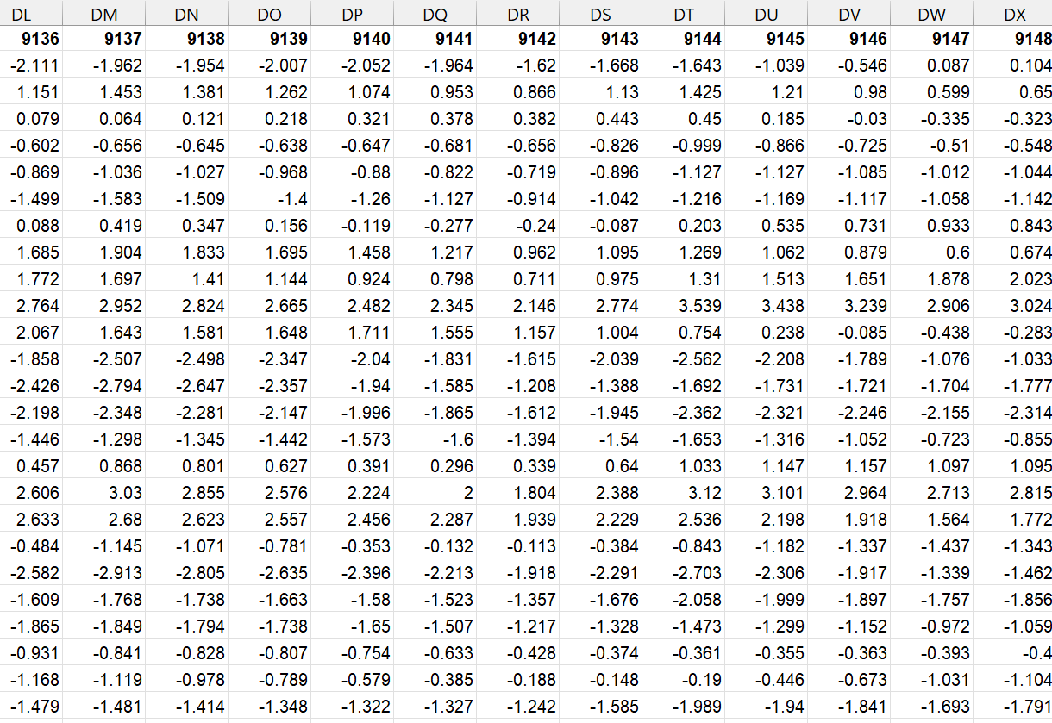
1. Format Data for Import
Recall the available data consists of 1) observed streamflow from 1932-2005 and 2) scPDSI gridpoint values within 450-km radius of SF Holston gauge from 365-2005.
scPDSI gridpoint data (red dots in figure) are structured as columns with the scPDSI index number as the column heading.
scPDSI values range from -4 to 4, with -4 indicating a very dry year and 4 indicating a wet year.
Example scPDSI data, with scPDSI index numbers in bold as column headings.
SF Holston Gauge Location

Slide 21
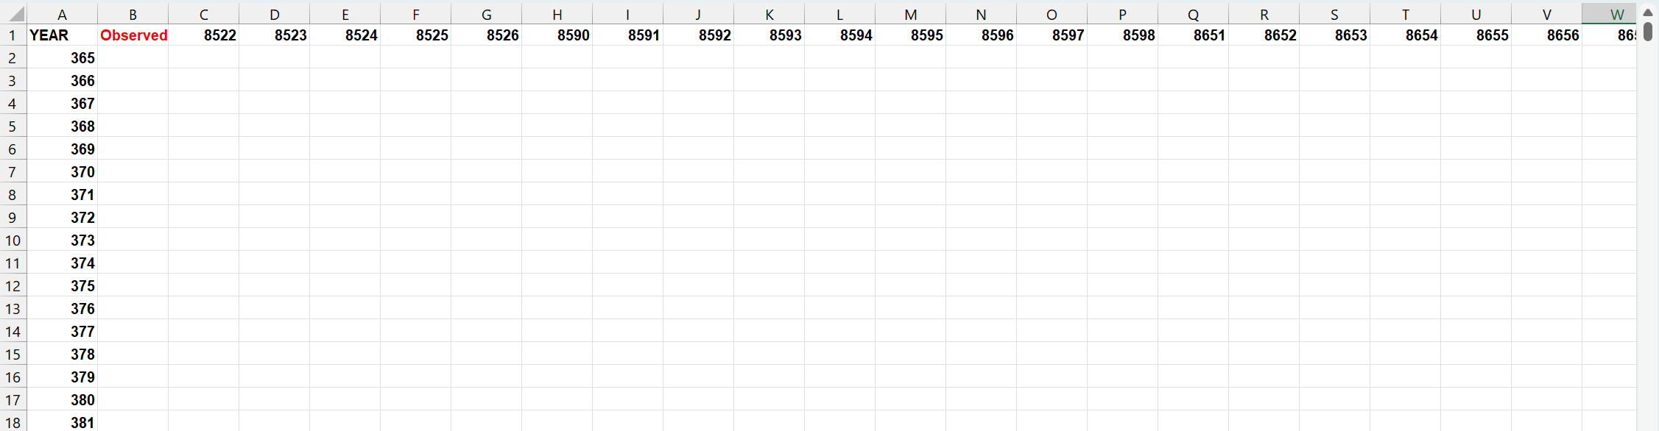
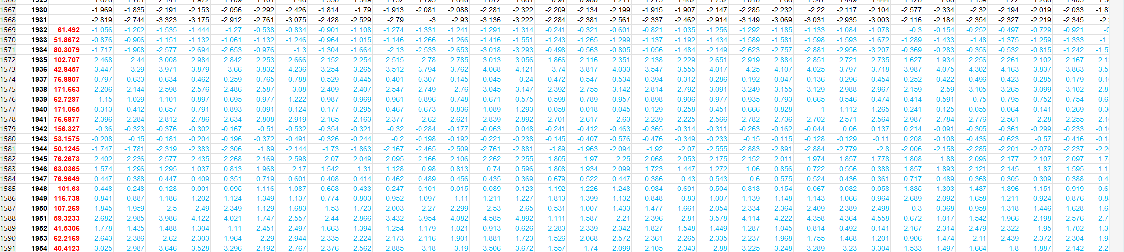
1. Format Data for Import
To format data for import into RapidMiner studio:
Condense to a single excel sheet.
Columns = Year, Observed, PDSI Index #’s
Blank values are okay for both observed and PDSI, this example contains some scPDSI points that do not extend back to year 365, while other scPDSI points have data for the entire 365-2005 range.
In this example, the first ~30 scPDSI gridpoints do not extend to 365. However, this data sheet is NOT blank!
Scroll down and to the right to ensure all your observed streamflow data and scPDSI data have copied over correctly. Now we see the data sheet is ready to import. (Year=first col, black; Observed=second col, red; scPDSI data=cols 3-252, black(non overlap) and blue (overlap))

Slide 22
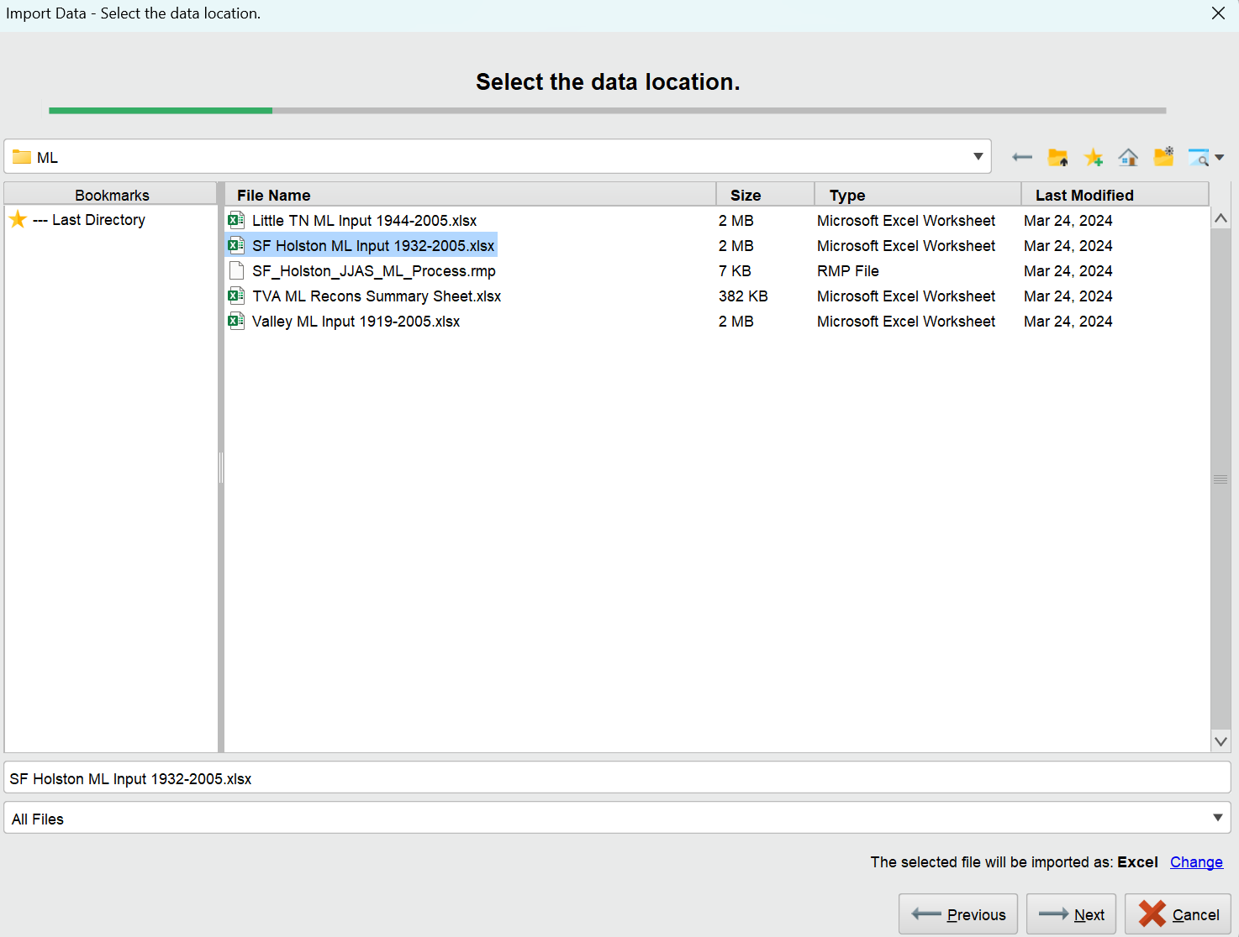
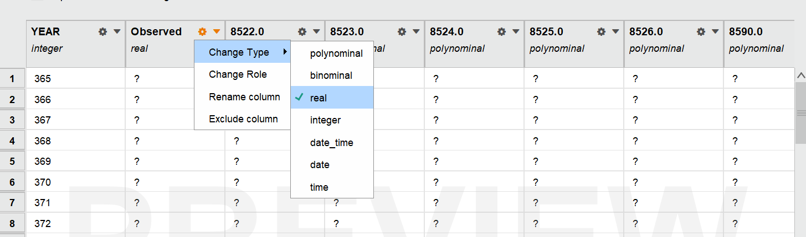
2. Import Data to Repository
Once your data has been formatted in excel, open RapidMiner Studio and start a Blank Process.
Select “Import Data” under the Repository Tab and select whether the data you’ve prepped is on your device or a database.
Our data is formatted in excel, so importing as Excel is OK. Hit “Next”
You’ll be prompted to select the cells for import. Since we already formatted the data, import all.
Make sure to select “Define header row: 1”
Hit “Next”
Now, you’ll be prompted to format your columns.
Year = INTEGER
Observed = REAL
scPDSI = REAL OR POLYNOMIAL
In this case, the formatted data was located on my device as an excel file. Keep in mind there are no right or wrong ways to format and import data for this application, whatever works best for you.
You may only have to change the type of observed from polynomial to real.

Slide 23
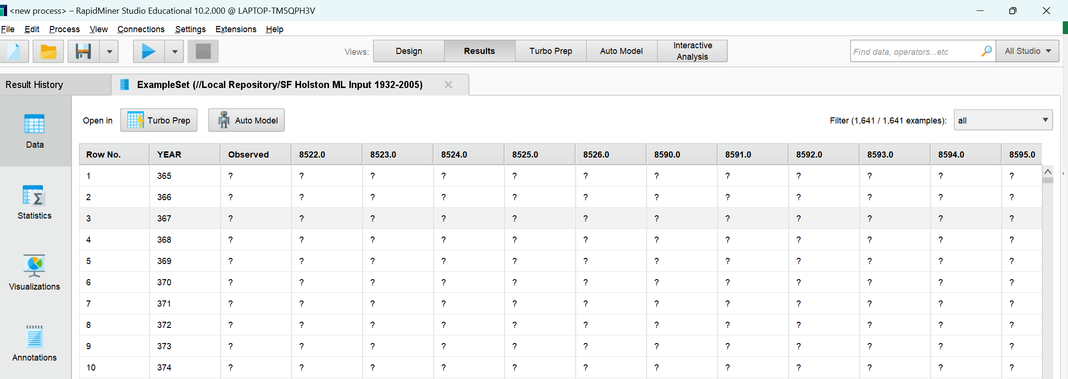
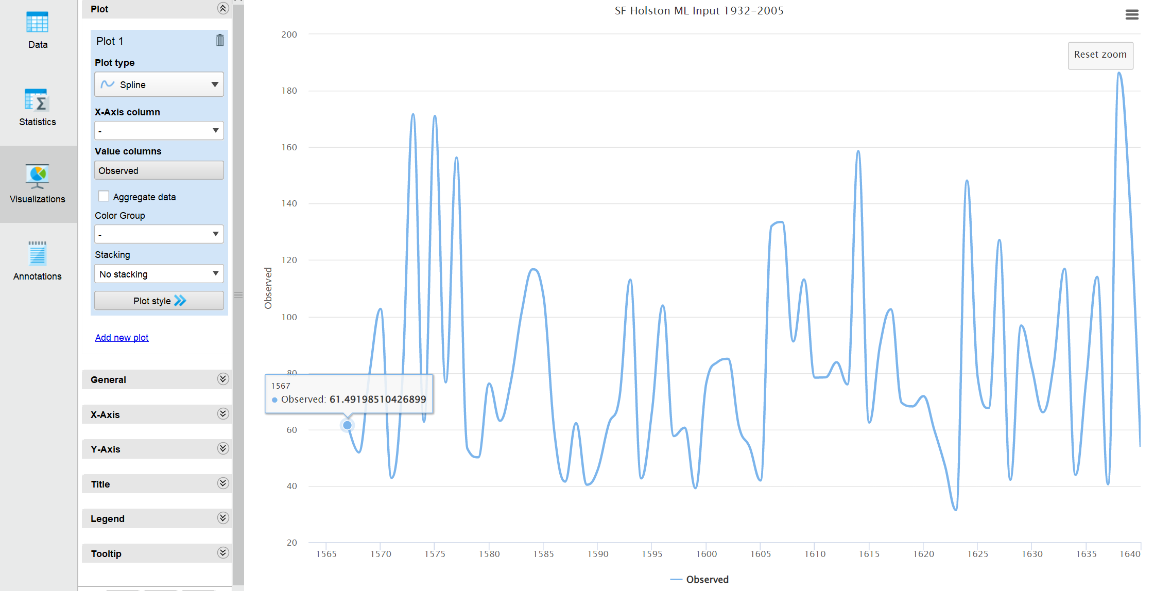
2. Import Data to Repository
Once the variable types (columns) have been formatted, click “Next”
You’ll then be prompted with where you want to store this data.
Simply select “Local Repository” and name your dataset for easy access when process building.
Select “Finish”
Once your data has been successfully imported into your RapidMiner Studio Repository, the Results View will automatically open with the data available for viewing, sorting, statistics, annotation, and visualization.
Results View opened after successful data import to view raw data.
Data visualization of observed streamflow for SF Holston Gauge (Results View -> Visualizations -> Spline)

Slide 24
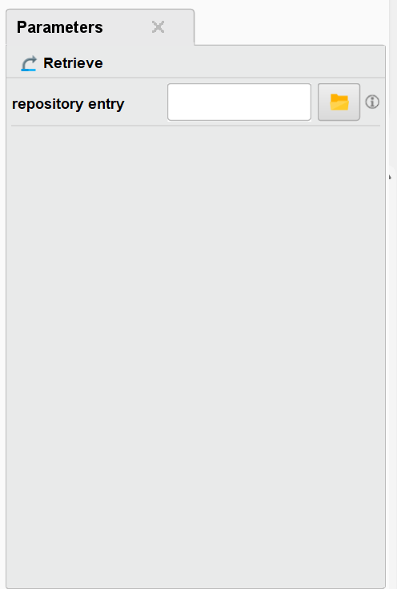
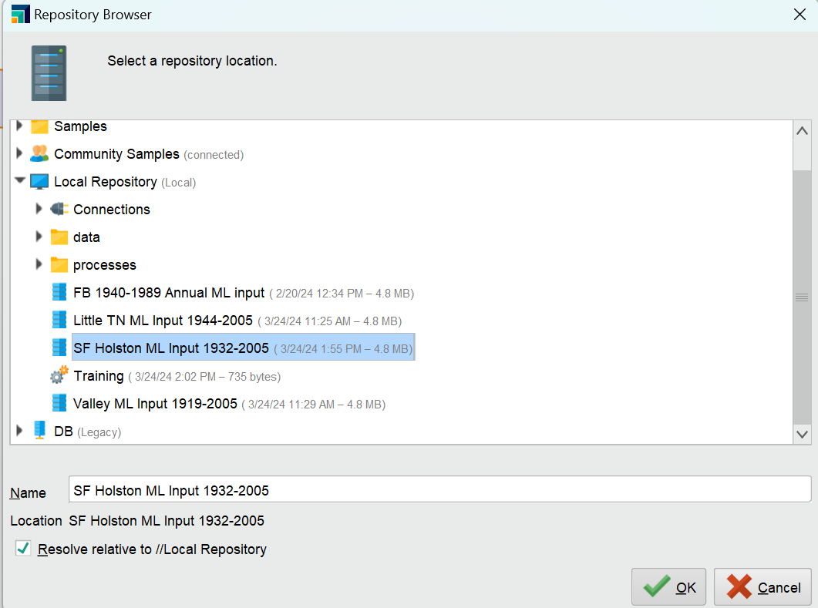
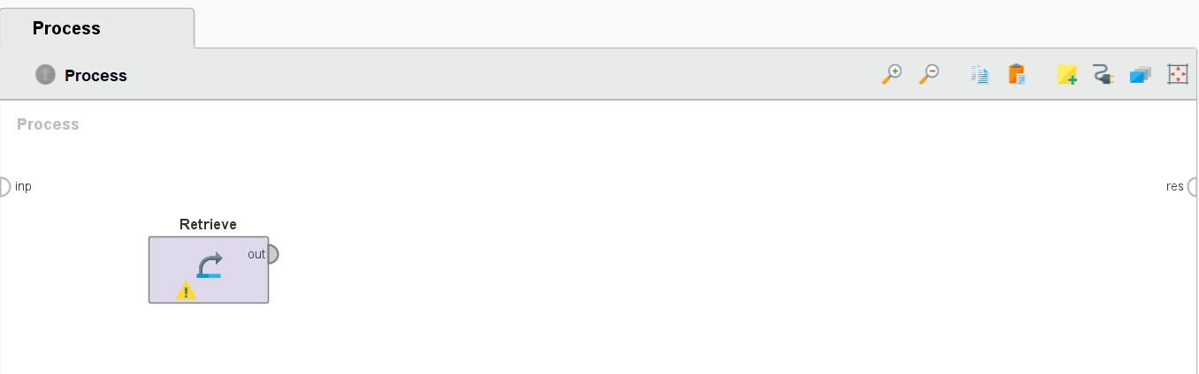
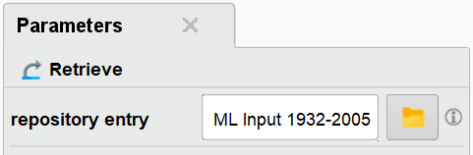
3. Retrieve Data in Process
Next, navigate back to the Design View to begin process building with the imported data.
In the Operator Panel- search “Retrieve” and select the operator under the Data Access folder called “Retrieve”
This operator can access stored information in the Repository and load them into the process.
Add this to your process by clicking and dragging into the process panel.
With the “Retrieve” Operator selected in your process space, navigate to the Parameters Panel
Select the folder icon next to “Repository Entry” and select the data you imported in step 2.
Ensure the data has been retrieved by checking the Operator’s parameters again.
The Repository Entry of the formatted data will be visible.

Slide 25
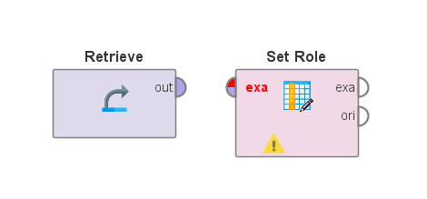
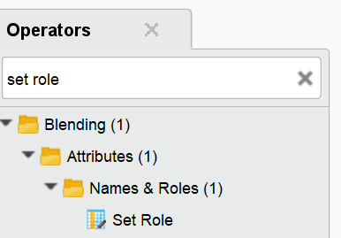
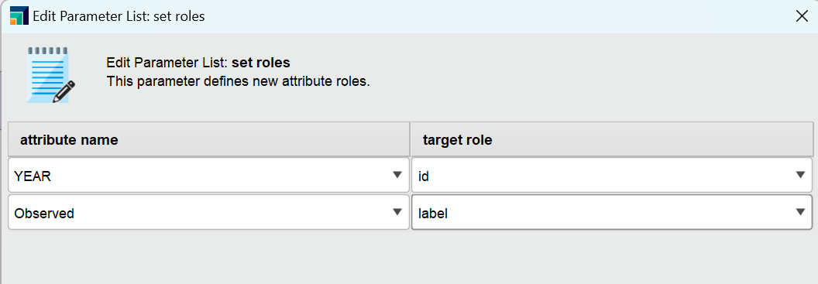
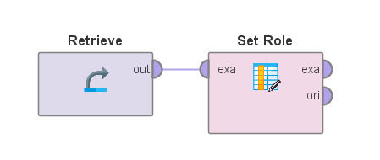
4. Select Data Roles
Once the data has been retrieved via “Retrieve” Operator in the Process Panel, we will connect the next Operator, “Set Role”
In the Operator Panel, search for “Set Role”, click and drag the operator into the process space.
This operator is used to change the role of one or more attributes.
Select the “Set Role” operator and navigate to its Parameters Panel.
Select “Edit List” from the Parameters Panel.
Attribute Name = YEAR; Target Role = ID
Attribute Name = OBSERVED; Target Role = LABEL
scPDSI data is not touched in this step.
Select “Apply”
Connect the output port from the “Retrieve” operator to the input (exa) port of the “Set Role” operator in the Process Panel.

Slide 26
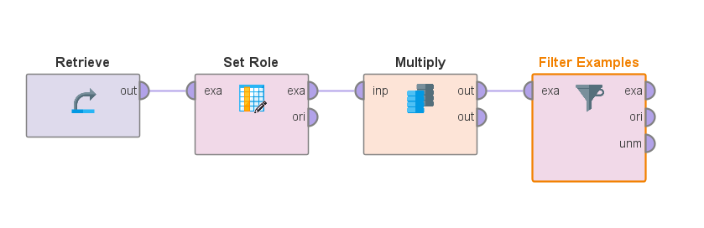
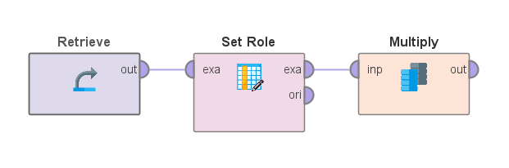
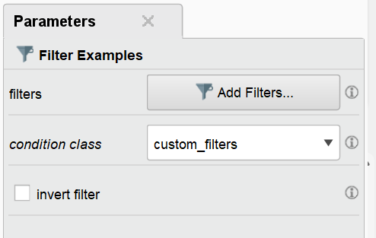
5. Filter Examples for Period of Observation
Once the data roles have been selected with the “Set Roles” Operator in the Process Panel, we will use a “Multiply” Operator to route the output from “Set Roles” to 1) Filter Examples and 2) Apply Model.
Search “Multiply” in the Operators Panel and drag and drop into the Process Panel.
This Operator creates a copy of a RapidMiner object and contains no parameters. It is a utility operator.
Connect the output from “Set Role” operator to the input of “Multiply” operator.
The “Filter Examples” Operator selects which examples of an exampleset (dataset) are kept and which are removed.
The filtered examples will be fed into the Cross Validation operator in the next step.
Once your process contains the two new operators, select “Filter Examples” operator and navigate to the Parameters Panel.
Select “Add Filters” with the condition class being “custom_filters”
Now, search for “Filter Examples” in the Operator Panel, drag and drop into the Process Panel, and connect the output of “Multiply” to the input of “Filter Examples”

Slide 27
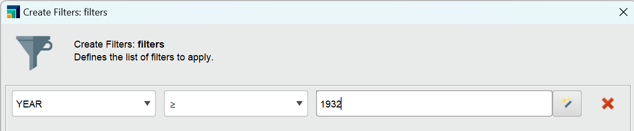
5. Filter Examples for Period of Observation
The purpose of this operator in the Process is to select the data within the years we have observed streamflow.
In this example, we have observed streamflow between the years of 1932 and 2005.
The custom filter we will create for this operator is to select the data from year 1932 to 2005.
This is done by setting YEAR greater than or equal to 1932 in the Parameters Panel for “Filter Examples” Operator.
Select “OK”

Slide 28
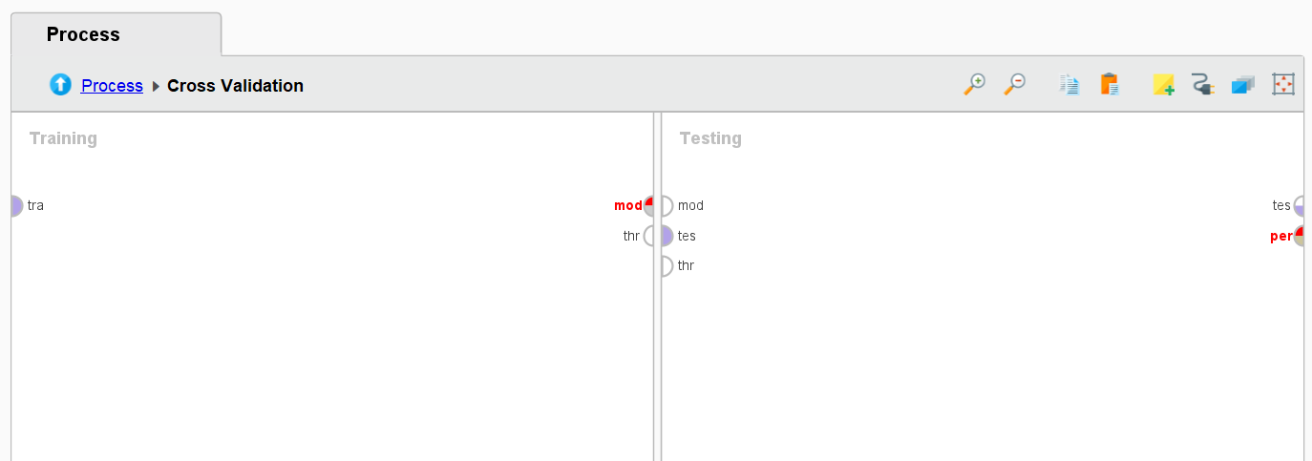
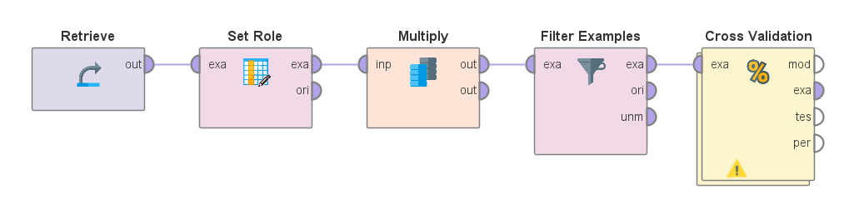
6. Cross-Validation
Once the data has been filtered with the “Filter Examples” Operator in the Process Panel, we will use the “Cross Validation” Operator to route the output from “Filter Examples” to Apply Model.
Recall the “Multiply” operator from the previous step. This is the data that will be routed to model application for a reconstructed vector rather than solely performance evaluation (done via “CV” operator).
Search for “Cross Validation” in the Operators Panel, drag and drop into Process Panel, and connect output from “Filter Examples” to the input of “Cross Validation”
This operator performs a cross validation to estimate the statistical performance of a learning model. It is mainly used to estimate how accurately a model (performed by a particular learning operator) will perform in practice.
Before manipulating the cross-validation parameters, this Operator contains a subprocess (split into training & testing) which will contain the following:
The learning model (ML algorithm) of interest
Training
Model Application for performance evaluation
Testing
To access the sub-process of training/testing within the CV operator, double click the operator in the Process Panel.
CV Sub-Process. Click “Process” in top right to return to the main Process Panel.

Slide 29
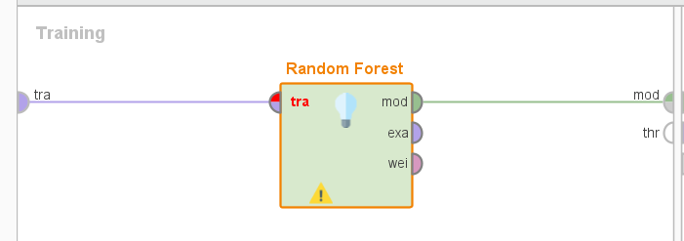
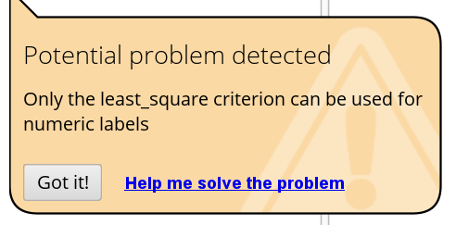
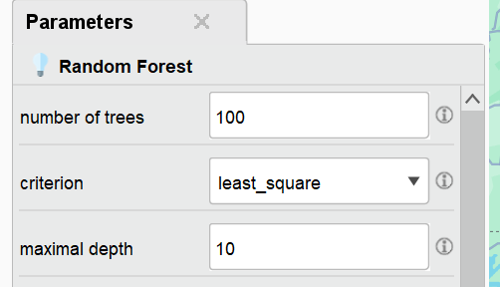
6. Cross-Validation
CV Subprocess Training:
In this example, we will use the Random Forest (RF) learning operator.
A random forest is an ensemble of a certain number of random trees, specified by the number of trees parameter. Each node of a tree represents a splitting rule for one specific attribute. In regression, it separates values in order to reduce the error made by estimation.
In this case, RF decides which scPDSI value reduces error of the estimated streamflow (result) vector.
Select “Random Forest” from the Operators Panel and drag and drop into the Training panel of the CV Subprocess.
Connect the “tra” (training) input port to the RF operator input, and RF model output port to the training model output port as shown to the right.
An error will immediately generate. Hover over the exclamation point on the operator to view the error.
The RF operator has a default criterion (in its Parameters Panel) of gain_ratio. RapidMiner’s error says that only least_square criterion can be used for numeric labels, so we much adjust that in the Parameters Panel for the RF operator.
Once fixed, the error message will disappear.
No other RF parameters are adjusted for this example (defaults).

Slide 30
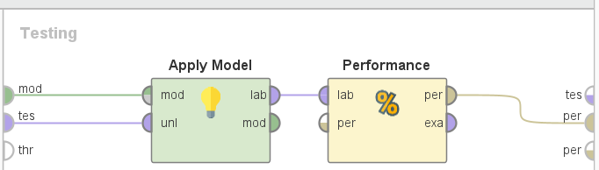
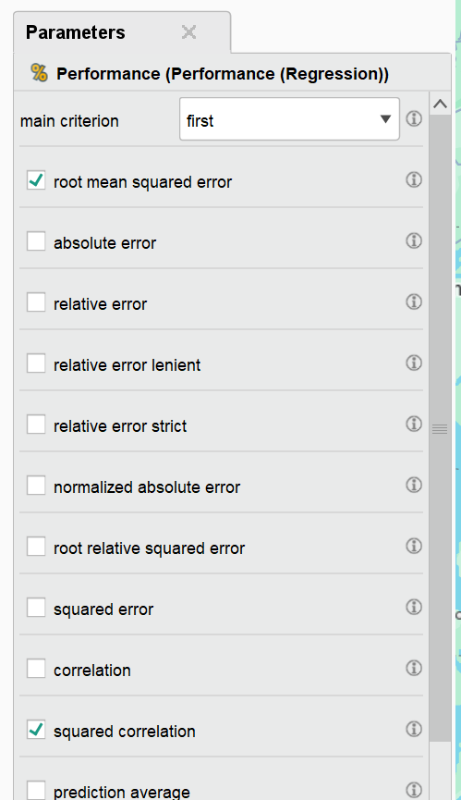
6. Cross-Validation
CV Subprocess Testing:
Select “Apply Model” from the Operators Panel and drag and drop into the Testing panel of the CV Subprocess.
This operator applies a model on an example set.
Select “Performance (Regression)” from the Operators Panel and drag and drop into the Testing panel of the CV Subprocess.
This operator is used for statistical performance evaluation of regression tasks and delivers a list of performance criteria values of the regression task.
Connect links (see figure to right)
Connect the Testing panel model input to the input port of “Apply Model”
Connect the Testing panel test input to the “uni” input port of “Apply Model”
Connect the “Performance” input to the output of “Apply Model”
Connect “Performance” output “per” to the performance output port of the testing panel.
Select “Performance” metrics to produce when running the model in its Parameters Panel.
This example will evaluate RMSE and R^2.

Slide 31
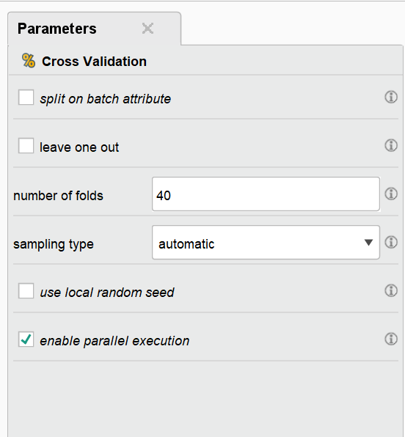
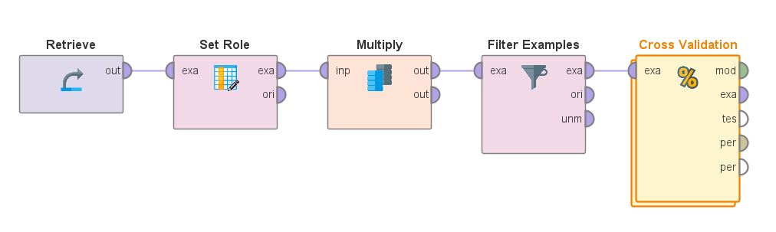
6. Cross-Validation
Return to the main Process Panel from the CV subprocess panel and select “Cross Validation” to view its Parameters Panel.
Navigate to the Parameters Panel for the parameter, number of folds.
This parameter specifies the number of folds (number of subsets) the ExampleSet should be divided into. Each subset has equal number of examples. The number of folds is also the number of iterations that will take place. If the model output port is connected, the training subprocess is repeated one more time with all Examples to build the final model.
For this example, we will use number of folds = 40.
All other parameters will remain their default values.

Slide 32
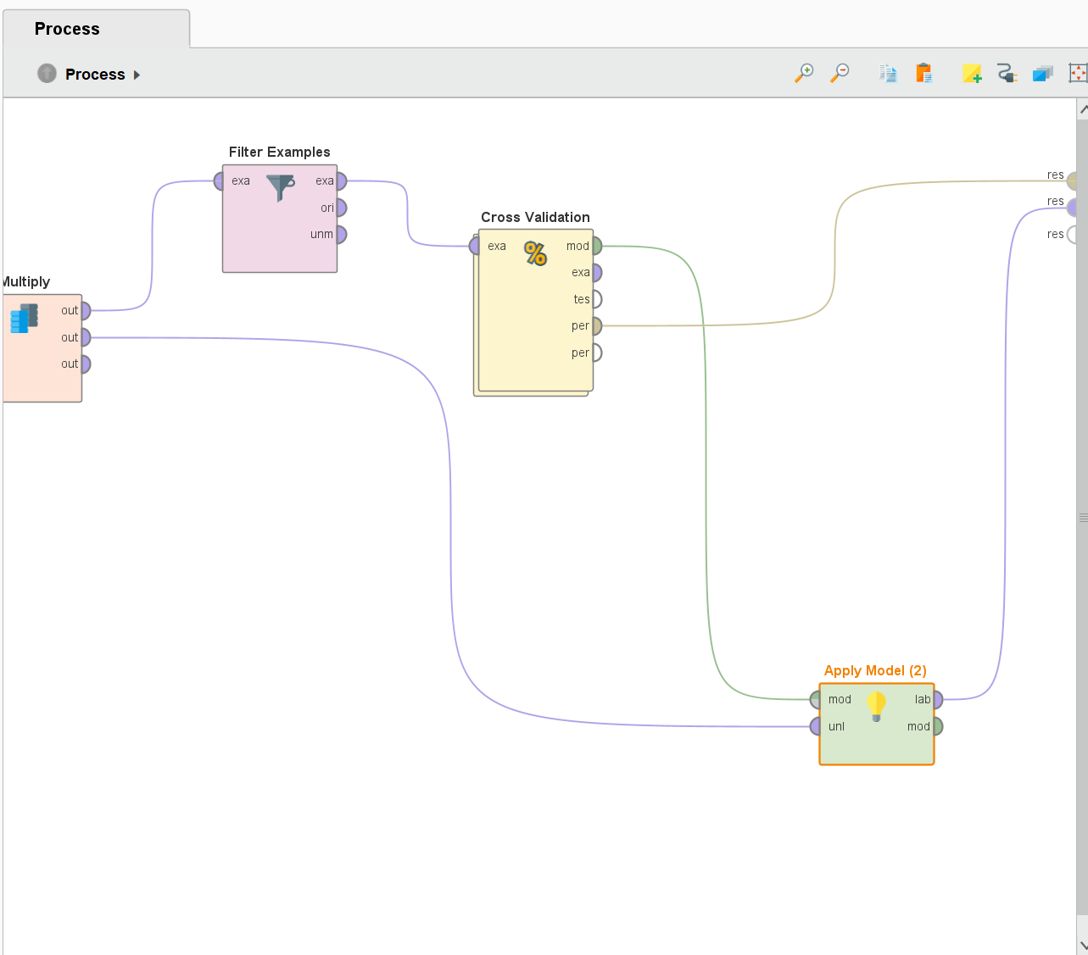
7. Model Application & Results
Add another “Apply Model” Operator to the main Process Panel
Recall the “Multiply” Operator from Step 5:
Create another output from the “Multiply” operator and connect to “uni” input on the new “Apply Model” operator in the main Process Panel.
Connect the CV model output to the model input on “Apply Model”
Connect the CV performance output to the results output, “res”
Connect the “Apply Model” output to an additional results output port.

Slide 33
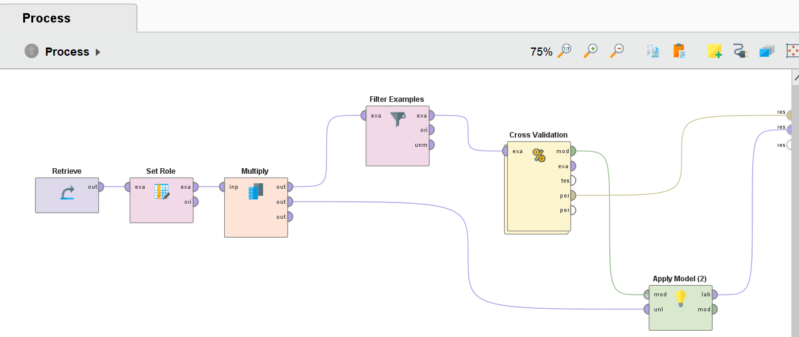

7. Model Application & Results
Final Process and CV Subprocess:

Slide 34


7. Model Application & Results
Now the model can be run using the play button near the top left corner.
Allow your device a few minutes to generate results. Once finished, the results view will automatically pop up.
Two tabs will contain results- the example set from model application (predicted streamflow values) and the performance vector, which will contain the RMSE and R^2 for the model.

Slide 35

7. Model Application & Results
Results:
RMSE = 23.943
R^2 = 0.700

Slide 36
References & Acknowledgements
RapidMiner Process Design for Paleo Climate Variable Reconstructions Courtesy of Abel Andrés Ramírez Molina, PhD Student, University of Alabama Department of Computer Science
Ramírez Molina, A.A.; Bezak, N.; Tootle, G.; Wang, C.; Gong, J. Machine-Learning-Based Precipitation Reconstructions: A Study on Slovenia’s Sava River Basin. Hydrology 2023, 10, 207. https://doi.org/10.3390/hydrology10110207
All RapidMiner Studio Tutorial / General Information Courtesy of RapidMiner, Inc (2024)
RapidMiner Documentation: https://docs.rapidminer.com/
Getting Started With RapidMiner Studio (V9.9): https://docs.rapidminer.com/9.9/studio/getting-started/index.html
Operator Reference Guide: https://docs.rapidminer.com/9.9/studio/operators/index.html
RapidMiner Community: https://community.rapidminer.com/
Additional Resources: https://docs.rapidminer.com/latest/resources/
Additional Acknowledgements:
This document and associated research used as an example therein are supported by the National Science Foundation Research Traineeship (NRT), Water: Research to Operations (Water: R2O) (#2152140) and The University of Alabama – Alabama Water Institute (AWI).

